Slide 1
Let’s Learn Korean Culture!
Future Designers
Week 2, Day 5

Slide 2
Facts about Korea
Official Name: Republic of Korea
Size: 100, 210 km^2
Capital: Seoul
Population: 51,441,201 (density 23rd)
Flag: Uses White, Black, Red, and Blue
Currency: Korean Won
Language: Hangul

Slide 3
History
Began in 7th Century BC
More than 5000 years of history
One-ethnic group
Many different kingdoms
VS Japan

Slide 4
Religion
Christianity is the leading religion, but most are not really religious
56.9% Unregistered
27.6% Christianity
15.5% Korean Bhuddhism

Slide 5
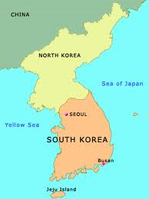
Korean War
Fought in 1950s
Between North and South
North supported by Soviet Union
Korea supported by USA
Ideological
Ethiopia: Brother Country
Sent out troops across great miles
Fought the most brutal front lines
Won almost always

Slide 6
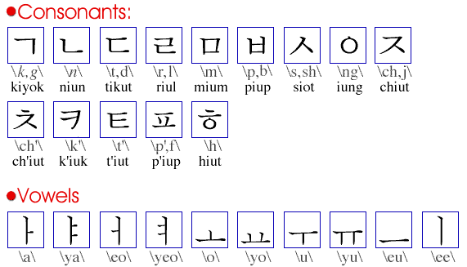
Korean Language
Hangul (한글)
Created by King Sejong
Known to be very scientific
Based on sounds
Let’s learn some Korean!
안녕 (Annyoung) – Hello, Bye
고맙습니다 (Gomapsupnida) – Thank you
사랑해요 (sarang haeyo) – I love ~

Slide 7
Sports
Two sports are the most popular:
Baseball
Football
Traditional sports
Taekwondo
Hapgido
Other sports:
Fencing
Ice Skating (Yuna Kim)

Slide 8
Korean Clothes
Traditional
Hanbok
Straight lines and beautiful colors
Modern
Fashionable clothes
Crazy about fashion
“Plastic Surgery Heaven”
Everyone dyes their hair, etc

Slide 9
Korean Heritage
Many temples and palaces
Especially in Seoul
Focuses on simple yet elegant designs
Gentle curves, symmetry, patterns

Slide 10
Environment
Temperate in nature
Seasons
Well defined
Spring, Summer, Fall, Winter
Lots of mountains
Three seas
Jeju Island

Slide 11
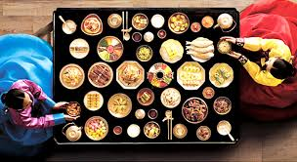
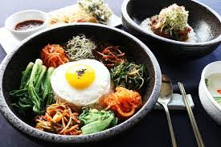
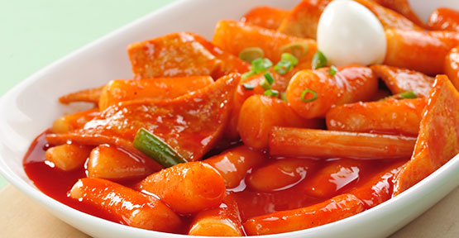
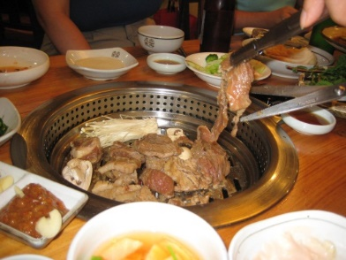
Korean Food
Uses many vegetables
Lots of side dishes
Hansik
Spices and Pepper!
Some representative food:
Bibimbap
Tteokbokki
Tangs (Soup)

Slide 12
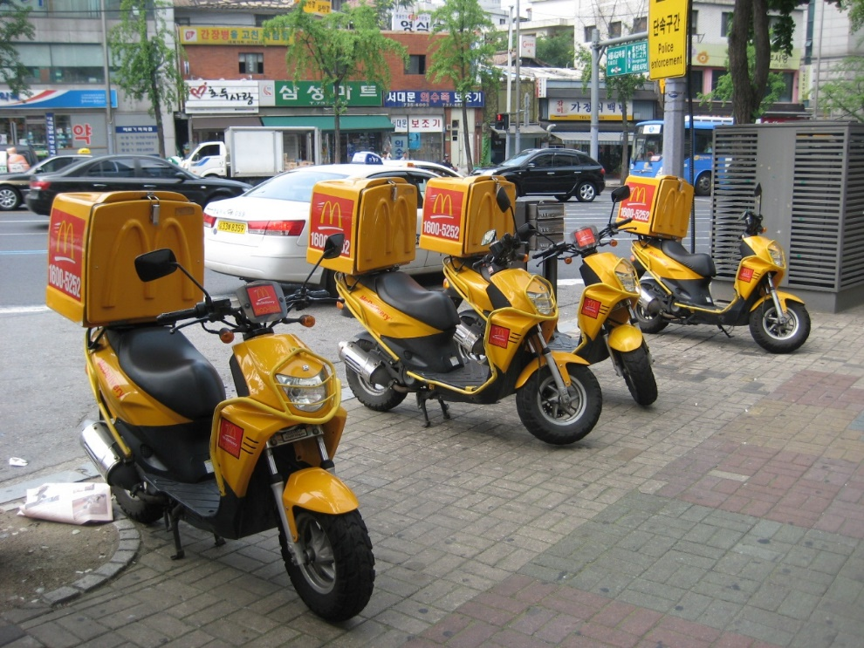
Exotic Food
We don’t eat dogs!
Live small octopus
Raw fish
Chicken Feet
Koreans love Delivery Food
Chicken
Most don’t like these really exotic ones and avoid it

Slide 13
K-POP
“Idol” groups consisting of many members
Usually a very active fan base
Many genres
Psy – Gangnam Style

Slide 14
KAIST!
Korea’s first institute of science and technology
Created in 1971
About 1000 students per year
4000 in undergraduates
10% International students
#1 IST in Korea

